Slide 1

DES 643
Group Project
AirAware VR:
Journey to Clean Air
Group Members :
Himanshu Patidar (210444)
Aman Kuldeep (210105)
Pranshu Mangal (210747)
Prishita Agrawal (210770)
Hridhan Patel (210687)
Preeti Meena (210765)
Sachin Meena (210890)

Slide 2

INTRODUCTION
Today, the intertwined issues of climate change and air pollution pose significant threats to our planet's health and longevity. Human activities like burning fossil fuels and deforestation have sped up climate change, causing global warming to escalate rapidly. Each day, we witness worsening effects, including rising temperatures and strained ecosystems.
Our project, "Air AwareVR: Journey to Clean Air," arises from a deep understanding of the urgency to address these critical issues. At its core, our initiative seeks to shine a light on the causes and effects of climate change while providing actionable solutions to mitigate its impacts.

Slide 3

The reality of global warming is dire, with Earth's temperature already exceeding 1.5 degrees Celsius above pre-industrial levels. This underscores the urgent need for action to avoid irreversible consequences. Melting glaciers could lead to rising sea levels, endangering coastal communities and biodiversity. Additionally, poor air quality, caused by pollutants like particulate matter and nitrogen oxides, not only threatens human health but also exacerbates climate change effects. From intensified heatwaves to disrupted weather patterns, the impacts of these intertwined crises are urgent and far-reaching.
Problem

Slide 4
"Air AwareVR: Journey to Clean Air" is a virtual reality (VR) initiative raising awareness on the primary causes of air pollution and climate change, while highlighting effective solutions. Through immersive VR experiences, viewers explore scenes depicting key contributors to these issues and impactful remedies. The project aims to spotlight often neglected root causes and advocate proactive measures over reactive responses. By engaging participants interactively, it aims to bolster comprehension and action towards combating air pollution and climate change.
How does this project help?

Slide 5

Exploring
THE VIRTUAL WORLD
01
Clean Travel
02
Power Pollution
Users are whisked to a busy roadside scene, vividly depicting vehicle pollution. The narrative advocates for public transportation as a pollution-reducing solution, offering statistics to empower sustainable travel choices.
In an industrial landscape, users witness the impact of coal-fired power plants, urging consideration of alternative energy like solar to reduce reliance on fossil fuels and environmental strain.
03
Meat's Footprint
04
Population Pressure
In a farm setting, users explore the environmental impact of animal agriculture, highlighting extensive land use and methane emissions from cattle. Promoting direct crop consumption over the indirect energy loss from feeding animals, it emphasizes sustainable food choices.
Population growth exacerbates emissions, deforestation, and resource strain, suggesting that having one fewer child per family can yield significant positive impacts surpassing other interventions.
05
Iceberg Warning
Rising global temperatures melt ice, leading to sea level rise and land submersion. Urgent action to reduce greenhouse gases is vital to prevent irreversible damage and protect our planet.

Slide 6
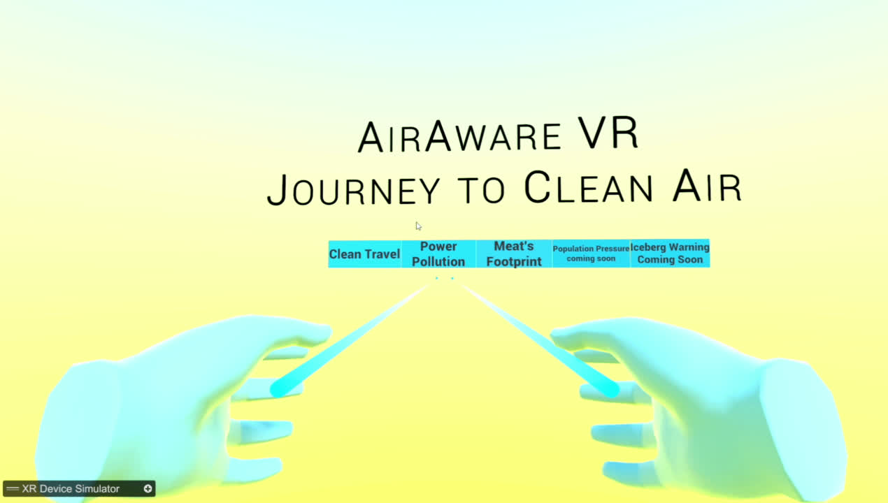
INTERFACE
Upon entering our Virtual World, users are greeted with a User Interface displaying five options: Clean Travel, Power Pollution, Meats Footprint, Population Pressure, and Iceberg Warning.

Slide 7
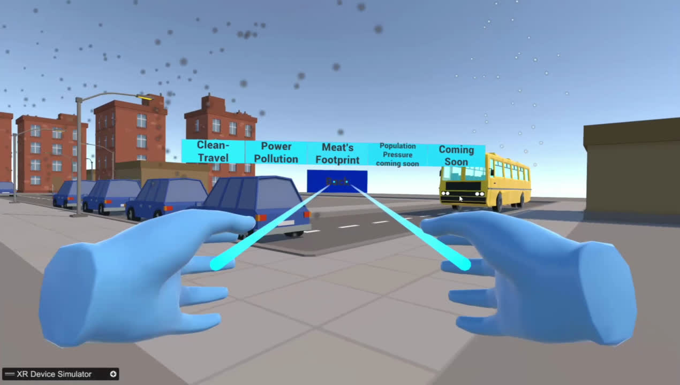
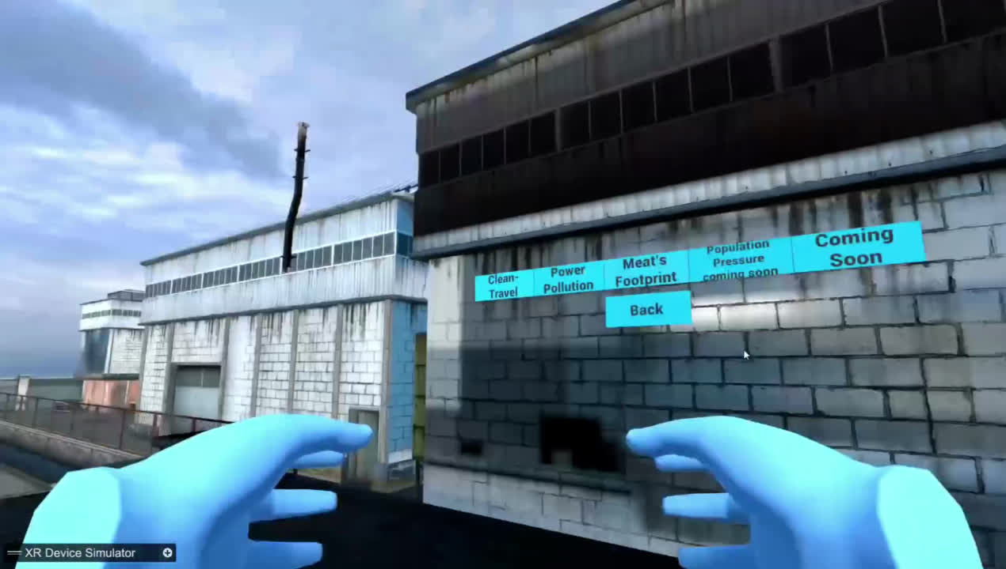
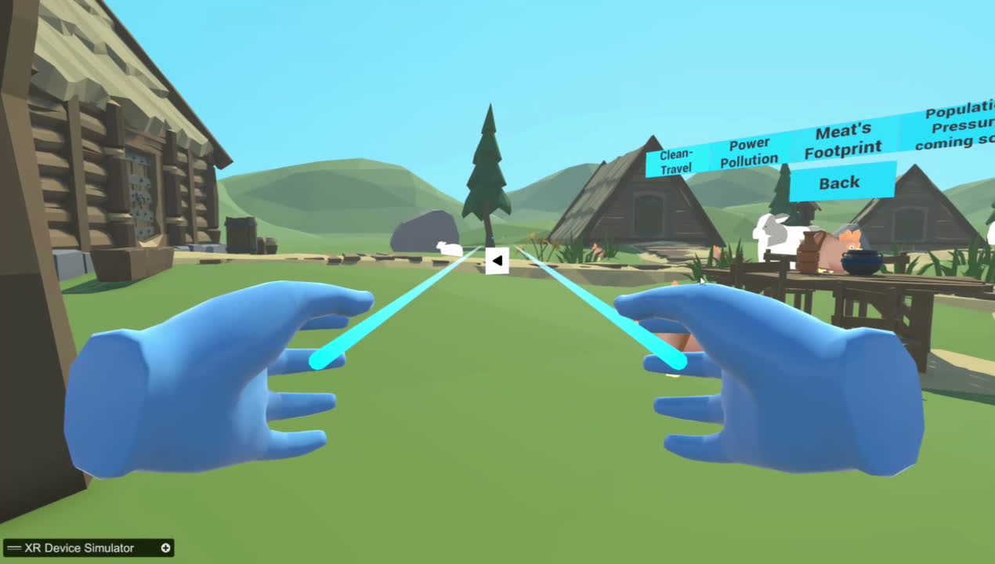

INTERFACE
Each option offers a unique perspective on pressing environmental issues, ranging from transportation emissions to population growth and climate change impacts.
CLEAN TRAVEL
POWER POLLUTION
MEAT’S FOOTPRINTS
POPULATION PRESSURE
ICEBERG WARNING

Slide 8
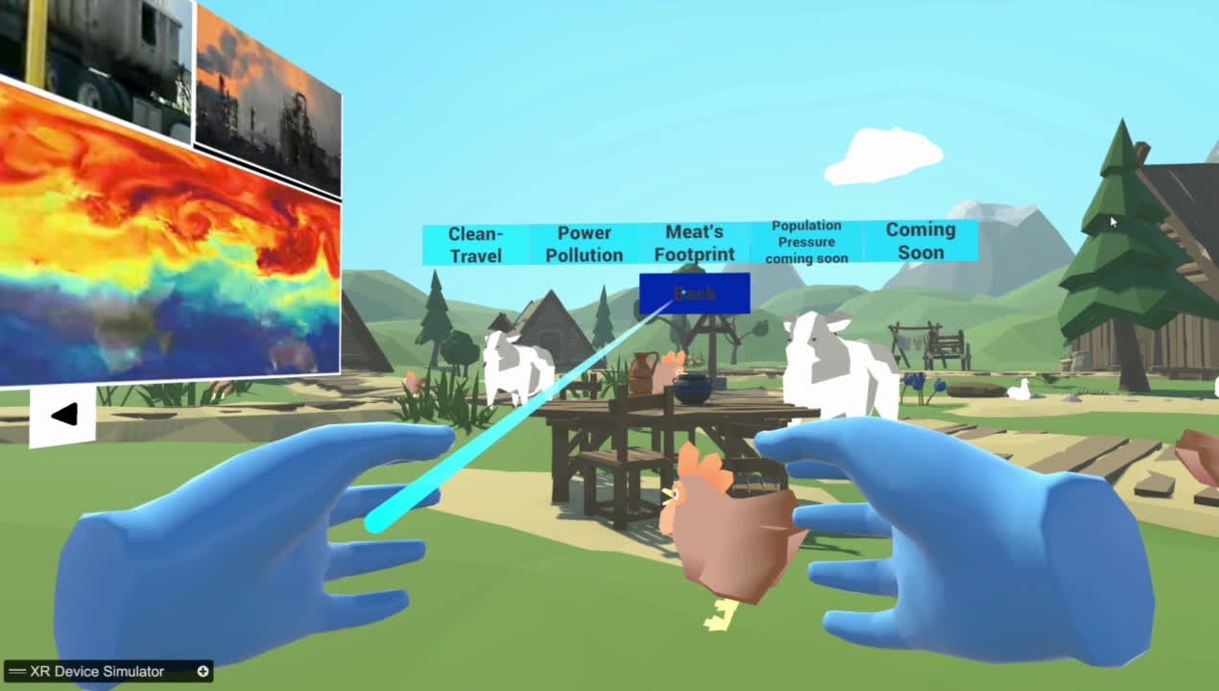
INTERFACE
Additionally, a "Back" button accompanies these options, allowing users to return to the main menu from any scene within the Virtual World with a simple click.

Slide 9


CLEAN TRAVEL
Upon selecting "Clean Travel," users are transported to a bustling roadside scene depicting vehicles in motion, vividly showcasing the magnitude of pollution generated. The narrative unfolds, highlighting the potential for pollution reduction through the adoption of public transportation. A compelling comparison is drawn, revealing that a single bus can effectively replace up to 75 cars while emitting pollution equivalent to only 10 cars. This underscores the significant environmental advantages of opting for public transport, not only in terms of emission reduction but also in fuel efficiency, ultimately contributing to a cleaner and healthier environment. By promoting sustainable travel choices, individuals can play a crucial role in mitigating air pollution and combating climate change.

Slide 11
POWER POLLUTION
Upon selecting "Power Pollution," users find themselves immersed in industrial zones, where the adverse effects of factory emissions are starkly depicted. The spotlight is on electricity-generating plants, particularly those reliant on coal, which are major contributors to pollution. The scene underscores the importance of reducing the demand for electricity from these industries. It advocates for the widespread adoption of solar panels in residential settings as a strategy to achieve this reduction in demand. By embracing solar energy at home, individuals can play a pivotal role in alleviating the strain on these factories, resulting in a significant decrease in pollution levels and fostering a healthier environment for all.

Slide 13
MEAT’S FOOTPRINTS
Upon selecting "Meats Footprints," users are transported to a bustling farm scene where they learn that two-thirds of agricultural land and one-third of the world's habitat are used for animal grazing. They discover the significant environmental impact of methane emissions from cattle, which are 22 times more harmful than CO2, prompting reflection on the consequences for climate change. Additionally, users are enlightened about the inefficiency of energy transfer in the food chain, advocating for a shift towards direct crop consumption to reduce energy loss and environmental strain, promoting sustainable dietary habits. This encourages users to consider the broader implications of their food choices on the planet.

Slide 15
POPULATION PRESSURE
The "Population Pressure" option underscores a paramount factor that eclipses others: the trajectory of population growth. Coupled with escalating consumption patterns, this phenomenon intensifies the emission of climate-altering greenhouse gases and drives deforestation, driven by the expanding need for both residential and agricultural land. The rapid surge in population exacerbates the ramifications of climate change by placing immense strain on finite resources. Advocating for smaller family sizes, this option emphasizes that the decision to have one fewer child per family could potentially yield a more profound positive impact than the cumulative implementation of all previously mentioned suggestions.

Slide 16
ICEBERG WARNING
The "Iceberg Warning" option emphasizes the consequences of rising global temperatures, particularly the alarming rate of ice melting. If this trend persists, there's an imminent risk of complete ice melt, leading to extensive issues such as drastic sea level rise and widespread land submersion. To avert such scenarios, urgent action is needed to curb greenhouse gas emissions and prevent further escalation of Earth's temperature. Failure to act promptly could render these changes irreversible, underscoring the urgency of our current window for intervention. Nonetheless, there remains an opportunity to mitigate these impacts to a certain extent and safeguard the planet and its inhabitants.

Slide 17
THANKYOU!!

